Slide 1


KICKSTART OF SELF-TAUGHT ON PYTHON
AALIM MUHAMMED SALEGH COLLEGE OF ENGINEERING
DEPARTMENT OF INFORMATION TECHNOLOGY
KICKSTART OF SELF-TAUGHT ON PYTHON
Facilitator
Er. K.Khaja Mohideen
Assistant Professor / Information Technology
Aalim Muhammed Salegh College of Engineering

Slide 2

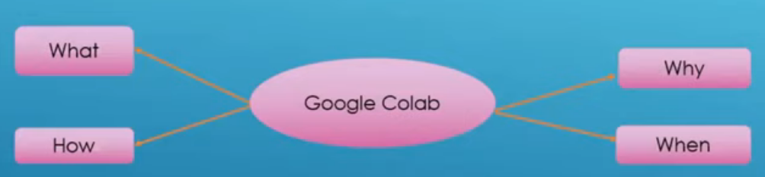
What is Colab?
AALIM MUHAMMED SALEGH COLLEGE OF ENGINEERING
DEPARTMENT OF INFORMATION TECHNOLOGY
MACHINE LEARNING MASTERCLASS
Colaboratory, or “Colab” for short, is a product from Google Research.
Colab allows anybody to write and execute arbitrary python code through the browser, and is especially well suited to machine learning, data analysis and education.

Slide 3
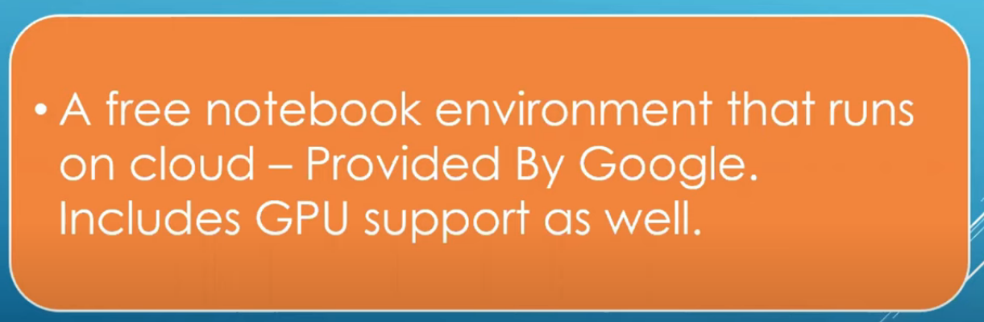
What is Colab?
AALIM MUHAMMED SALEGH COLLEGE OF ENGINEERING
DEPARTMENT OF INFORMATION TECHNOLOGY
MACHINE LEARNING MASTERCLASS
Colab, or "Colaboratory", allows you to write and execute Python in your browser, with
Zero configuration required
Free access to GPUs
Easy sharing
Whether you're a student, a data scientist or an AI researcher, Colab can make your work easier.

Slide 4
More on Colab
AALIM MUHAMMED SALEGH COLLEGE OF ENGINEERING
DEPARTMENT OF INFORMATION TECHNOLOGY
MACHINE LEARNING MASTERCLASS
Google Colaboratory is the perfect chromebook coding experience for any students to learn Python
Google Colab Tutorial for Beginners | Get Started with Google Colab
https://www.youtube.com/watch?v=RLYoEyIHL6A
Click URL below for More on COLAB https://colab.research.google.com
https://www.youtube.com/watch?v=inN8seMm7UI

Slide 5
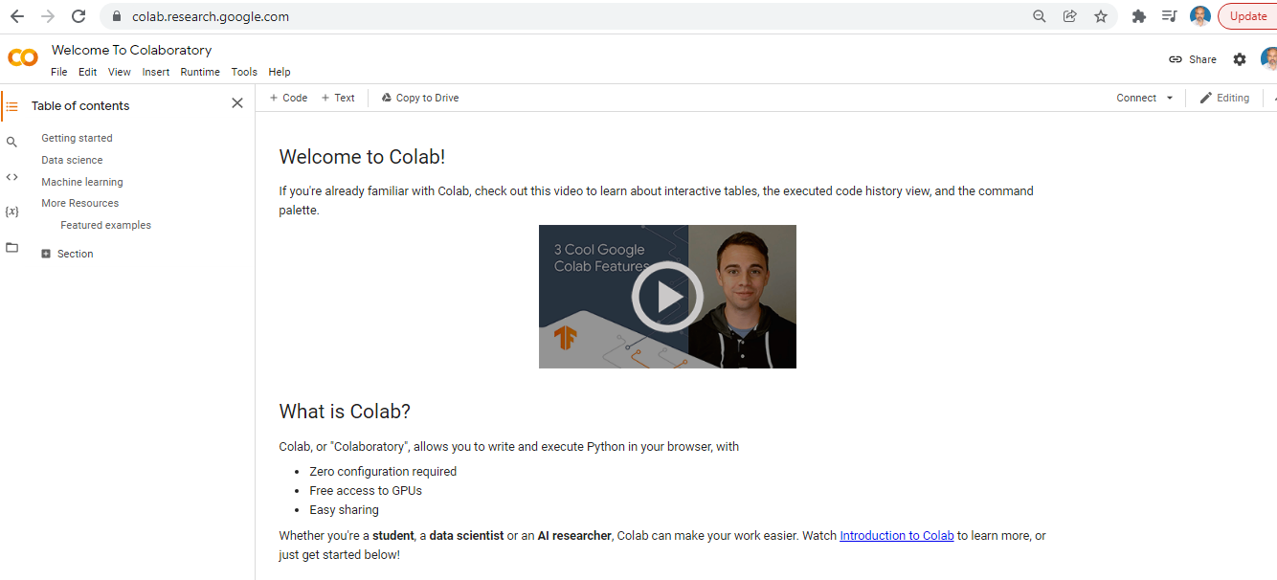
More on Colab – type : https://colab.research.google.com/
AALIM MUHAMMED SALEGH COLLEGE OF ENGINEERING
DEPARTMENT OF INFORMATION TECHNOLOGY
MACHINE LEARNING MASTERCLASS

Slide 6
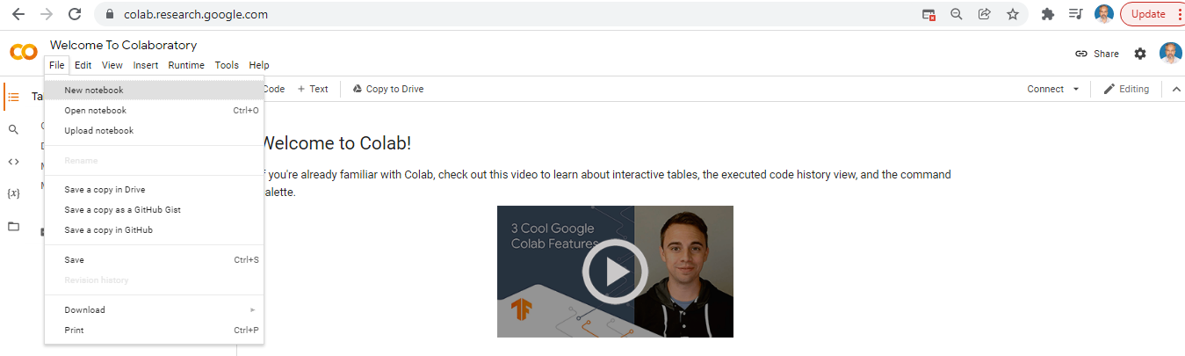
More on Colab – click : File → New Notebook
AALIM MUHAMMED SALEGH COLLEGE OF ENGINEERING
DEPARTMENT OF INFORMATION TECHNOLOGY
MACHINE LEARNING MASTERCLASS

Slide 7
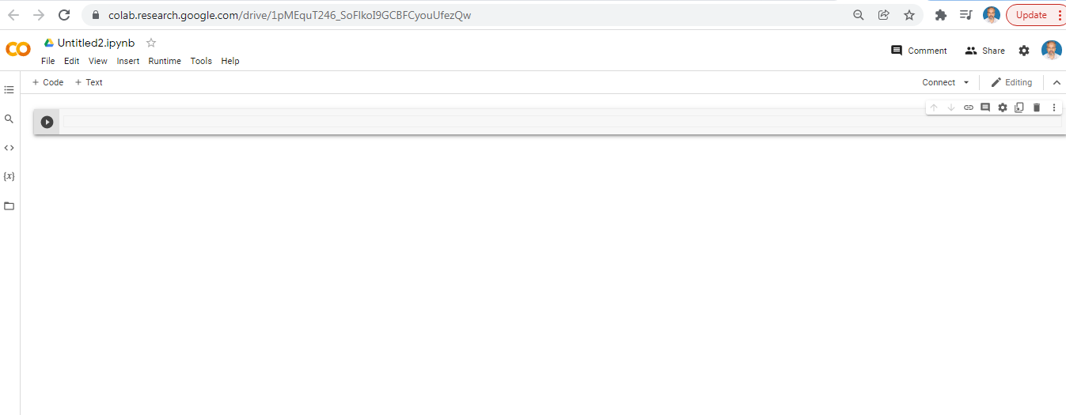
More on Colab – click : File → New Notebook
AALIM MUHAMMED SALEGH COLLEGE OF ENGINEERING
DEPARTMENT OF INFORMATION TECHNOLOGY
MACHINE LEARNING MASTERCLASS

Slide 8
More on Colab – Change Notebook name as below:
AALIM MUHAMMED SALEGH COLLEGE OF ENGINEERING
DEPARTMENT OF INFORMATION TECHNOLOGY
MACHINE LEARNING MASTERCLASS
Change the Title as
mypythonCourse
Now the Title becomes:
mypythonCourse.ipynb

Slide 9
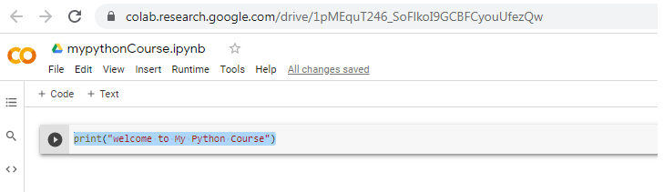
More on Colab – Change Notebook name as below:
AALIM MUHAMMED SALEGH COLLEGE OF ENGINEERING
DEPARTMENT OF INFORMATION TECHNOLOGY
MACHINE LEARNING MASTERCLASS
Type code as:
print("welcome to My Python Course")
Click on the Play-Push Button and verify your Python code Output

Slide 10
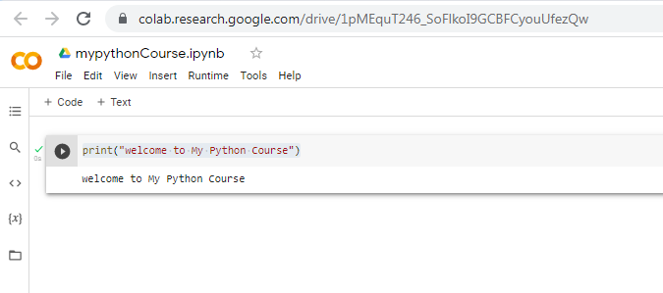
More on Colab – Verify python output:
AALIM MUHAMMED SALEGH COLLEGE OF ENGINEERING
DEPARTMENT OF INFORMATION TECHNOLOGY
MACHINE LEARNING MASTERCLASS
Type code as:
print("welcome to My Python Course")
Click on the Play-Push Button and verify your Python code Output

Slide 11
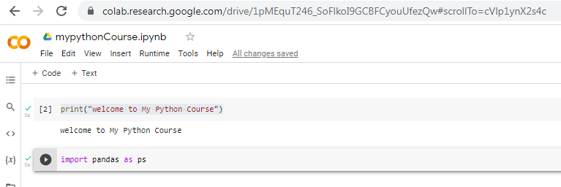
More on Colab – Verify python output:
AALIM MUHAMMED SALEGH COLLEGE OF ENGINEERING
DEPARTMENT OF INFORMATION TECHNOLOGY
MACHINE LEARNING MASTERCLASS
Importing Python Libraries:
Import pandas as ps

Slide 12
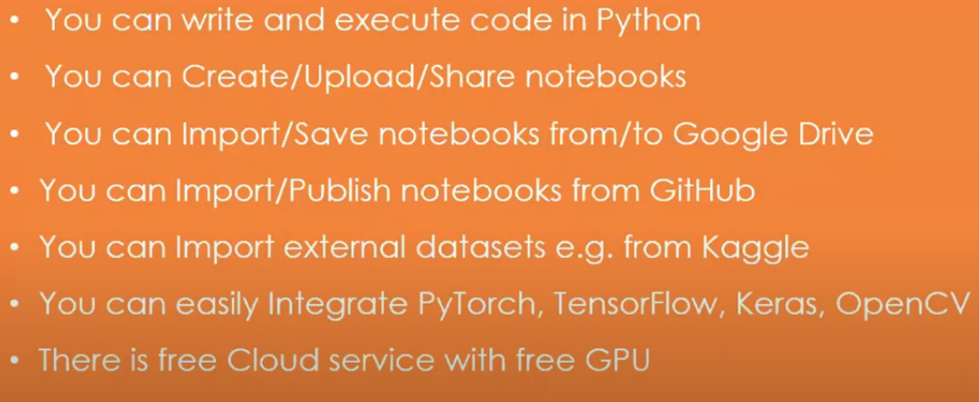
Why Google colab?
AALIM MUHAMMED SALEGH COLLEGE OF ENGINEERING
DEPARTMENT OF INFORMATION TECHNOLOGY
MACHINE LEARNING MASTERCLASS

